Slide 1
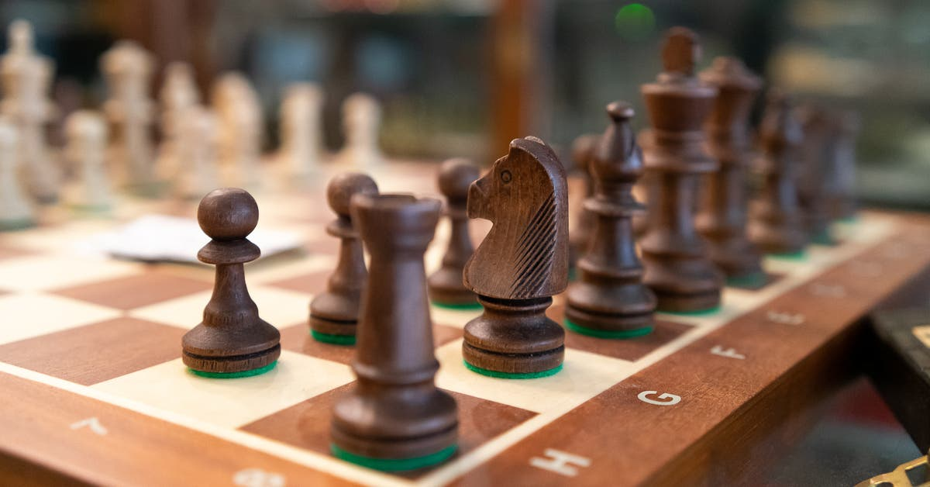
OUR CHESS AGENT
Nishmitha Leelakrishnan
Salman Shaik

Slide 2
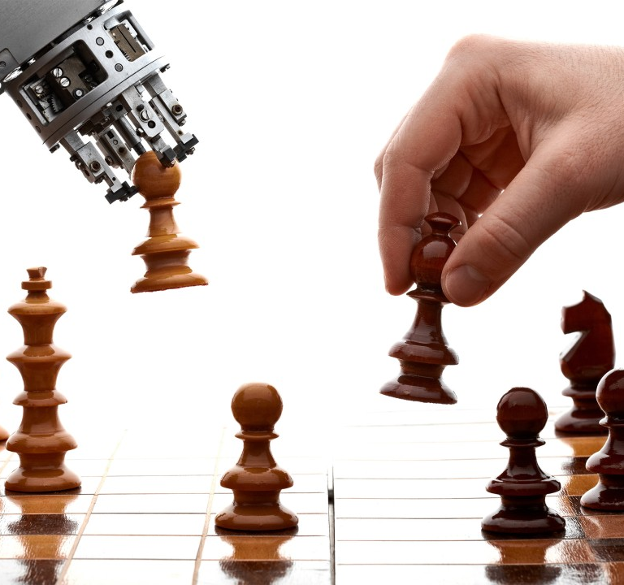
Agenda
Introduction
Requirements
Files to be Included
Representation of Moves
Move Selections
Chess Pieces
Objective
Approach
Methodology
Algo used

Slide 3

Chess Game
Chess is a two-player board game that falls under the category of abstract strategy games. Devoid of hidden information, it is conducted on a chessboard comprising 64 squares organized in an eight-by-eight grid.
Artificial intelligence finds extensive application in real-world everyday scenarios. Chess stands out as a game that showcases the impressive utilization of artificial intelligence.

Slide 4

Requirements
Python 3.10 version
PIP (performance improvement plan) for libraries installation.
PyGame- It is an open-source Python programming language module created to support the creation of multimedia apps and games.
Time - Provides ways to represent time in code, including objects, numbers, and strings. It not only represents time, but it also provides functionality such as waiting during code execution and measuring code efficiency.

Slide 5
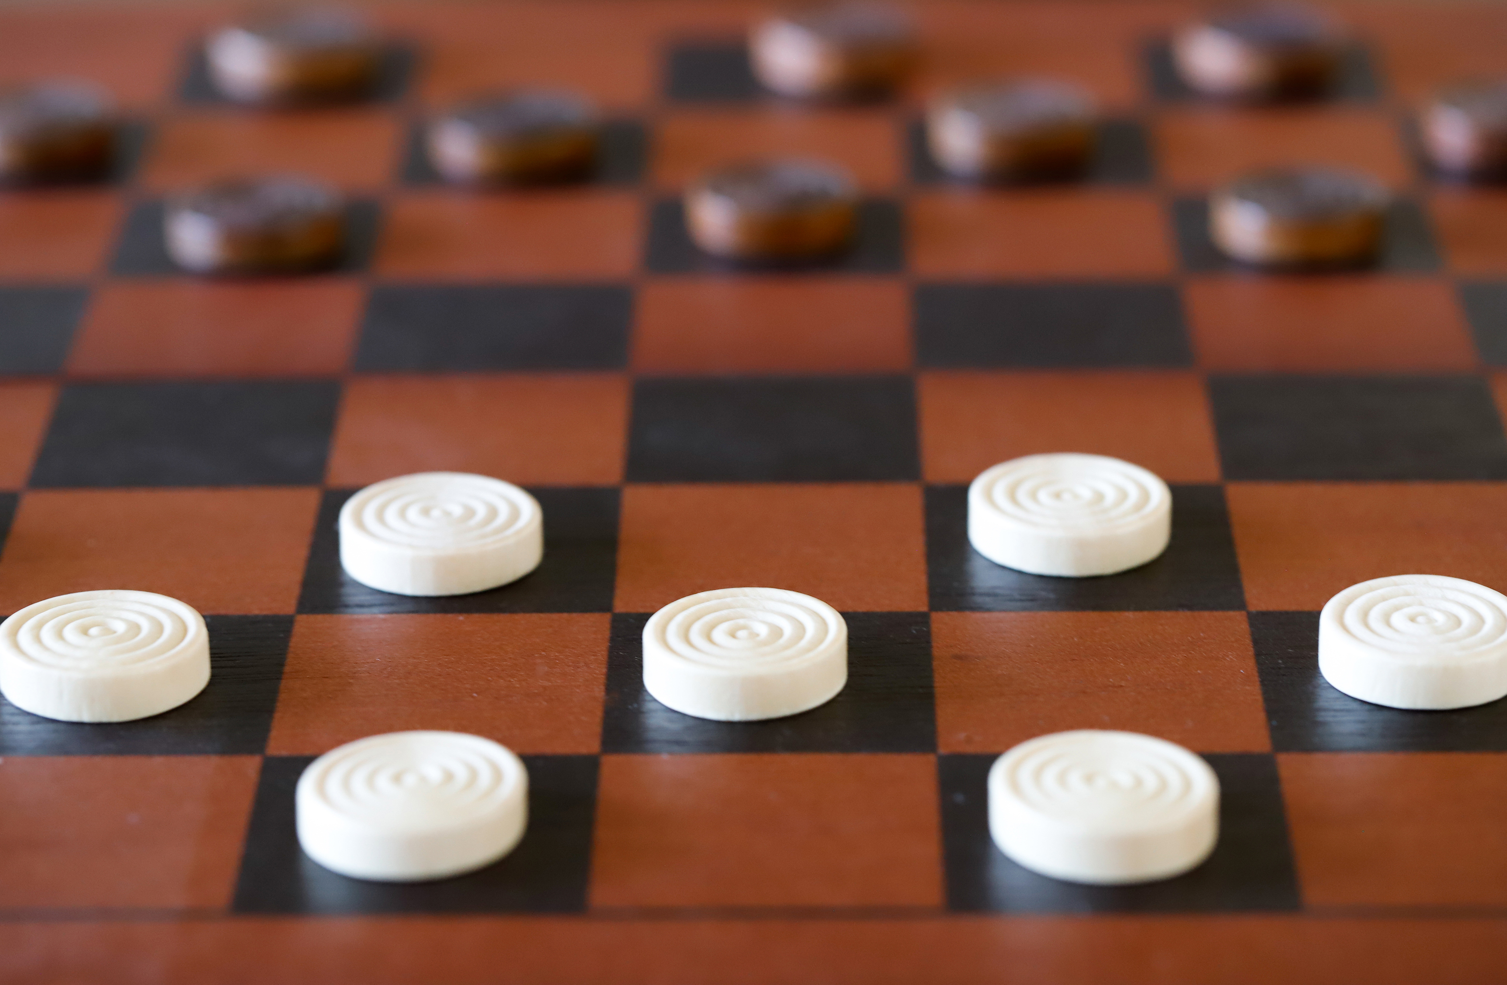
File uploaded
assets folder: Contains all the chess piece sprites used for the game’s graphics.
chess.py: The main program used to run the interface and game. Run this program when starting the game.
pieces.py: Contains the master class ‘Pieces’ as well as all individual piece classes that inherit the main class.
board.py: This contains the board class and its methods. Also contains the alpha-beta pruning method that the computer uses to make moves that.
ratings.py: Contains the rating class with methods that evaluate the rating of a move.
userInterface.py: Contains the user-interface class that is used to play the game and display the game using pygame.

Slide 6
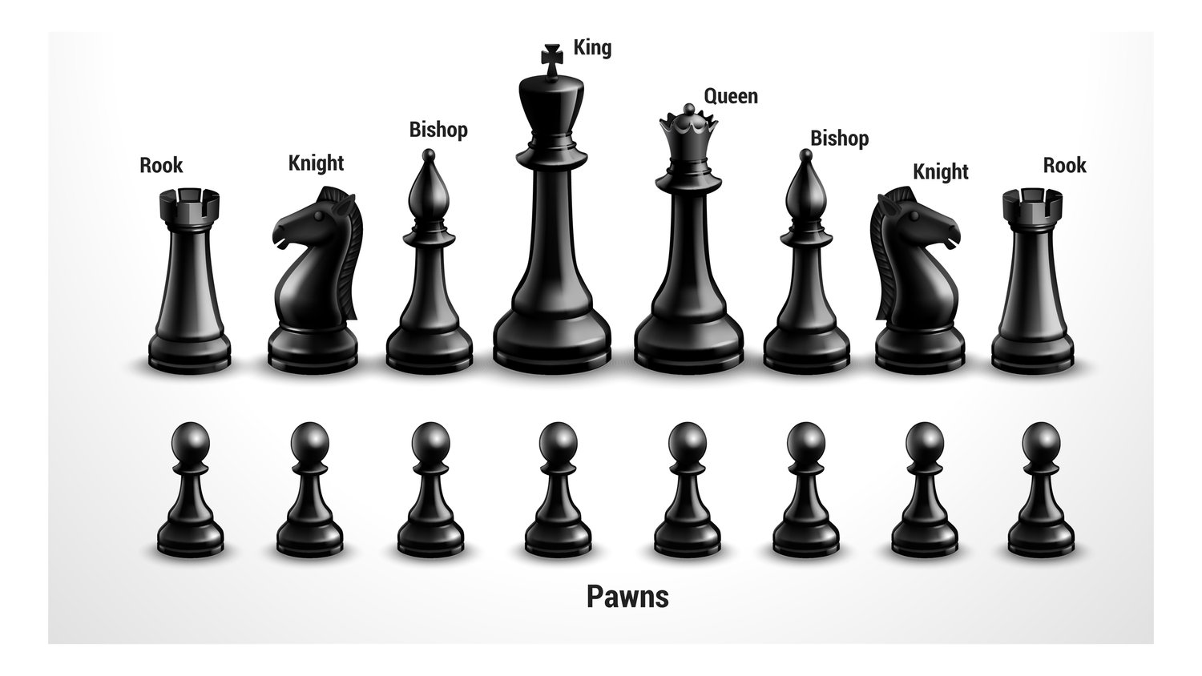
Board & Moves

Slide 7

Move Selections
The person who chosen white pieces needs to take the first move.
And he had the opportunity to attack first.

Slide 8

Chess Piece Movements
KING- The King, distinguished by a crown adorned with a cross, possesses the ability to traverse one square in any direction. This includes horizontal, vertical, or diagonal movements.
Queen - The queen has the capability to traverse any number of squares in any direction—horizontally, vertically, or diagonally. Regarded as the most potent piece on the chessboard.
Rook- The rook resembles a tower from an ancient structure and is a formidable piece. It possesses the ability to traverse the entire board either horizontally or vertically, covering any number of squares.
Bishop- The bishop is capable of moving along the diagonals of the chessboard, both upwards and downwards. It is restricted to diagonal movements and cannot transition between squares of different colors.

Slide 9
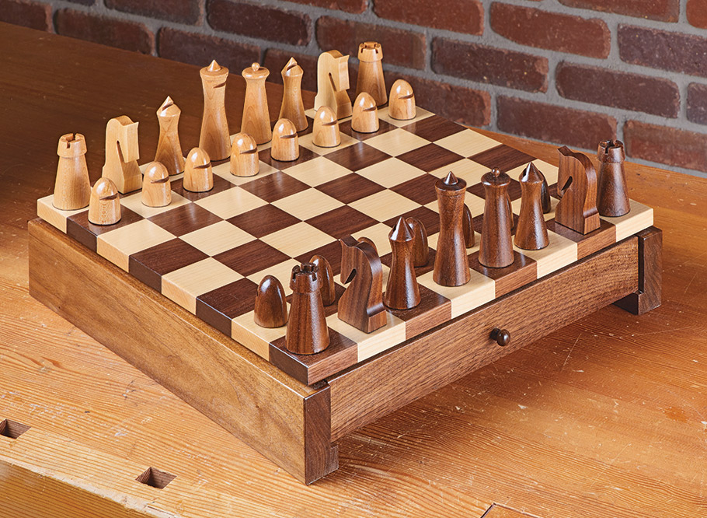
Knight- The knight moves in an "L" shape, advancing two spaces vertically and one space horizontally, or vice versa—two spaces horizontally and one space vertically.
Pawns- Pawns have the ability to move one square forward, except for their initial move when they can advance two squares. Importantly, they lack the capacity to move backward, distinguishing them from other chess pieces.

Slide 10
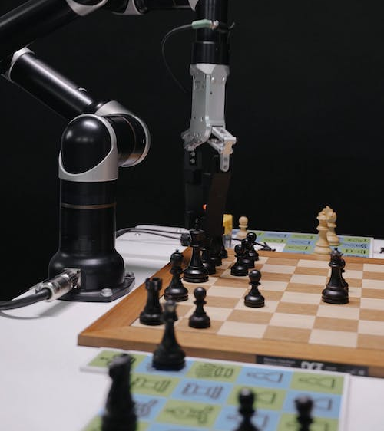
OBJECTIVE
This project aims to create a chess game with two distinct modes - player versus player and player versus artificial intelligence. It will be implemented through the utilization of object-oriented programming, the minimax algorithm, and Python with the Pygame library to ensure full functionality.

Slide 11
APPROACH
Tools
Python Interpreter.
Anaconda.
Powershell.
Techniques
Move generation and board visualization
Position Evaluation
Search tree using Minimax
Alpha beta pruning

Slide 12
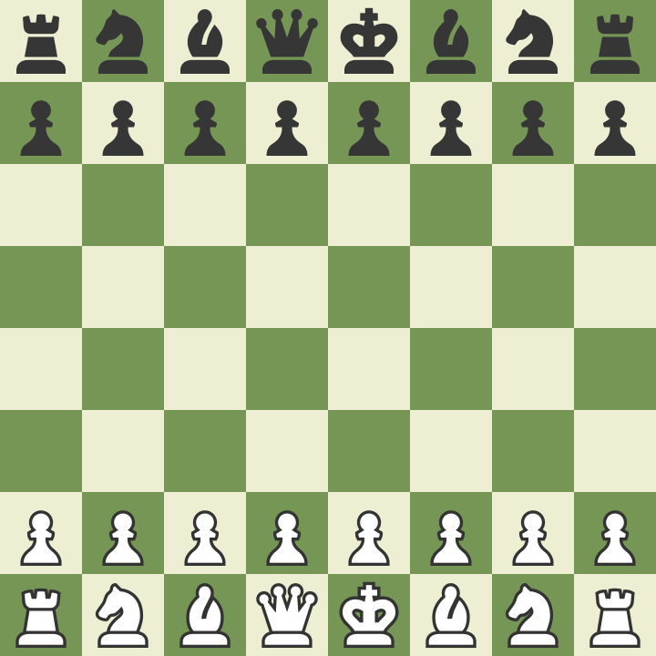
EVALUATION METHODOLOGY
Guaranteeing the validity of moves, distinguishing between valid and invalid actions.
Evaluating potential check situations on the chessboard.
Comparing the computational efficiency with that of other online chess games.
Measuring the duration, the algorithm requires to determine the subsequent move.
This project is a comprehensive undertaking that enables players to engage in a game against an AI algorithm developed using the Pygame library.
DELIVERABLES
YouTube link of the game.
Complete project uploaded in a Zip file.

Slide 13
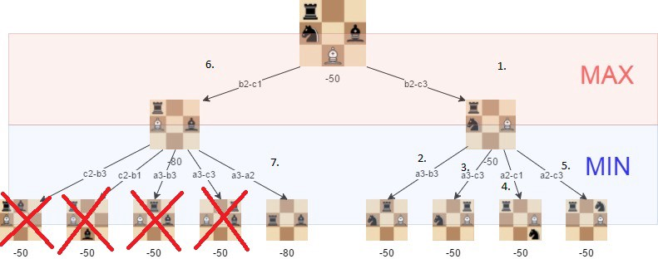
Alpha Beta Pruning
Alpha–beta pruning is a search algorithm designed to reduce the evaluation of nodes within the search tree by the minimax algorithm. This adversarial search algorithm is frequently employed in the machine play of two-player games.
Alpha is defined as the optimal (highest-value) selection identified thus far along the Maximizer's path. The initial value for alpha is set to negative infinity.
Beta is defined as the optimal (lowest-value) selection identified thus far along the minimizer path. The initial value of beta is set to negative infinity.

Slide 14

Algorithm Explained
For this chess game alpha-beta algorithm is used
The algorithm keeps track of two values, namely alpha and beta, signifying the minimum score guaranteed for the maximizing player and the maximum score assured for the minimizing player, respectively.
Initially alpha = - Infinity and beta = + Infinity
The present maximum depth assesses a range encompassing three players.

Slide 15
THANK YOU

